Slide 1
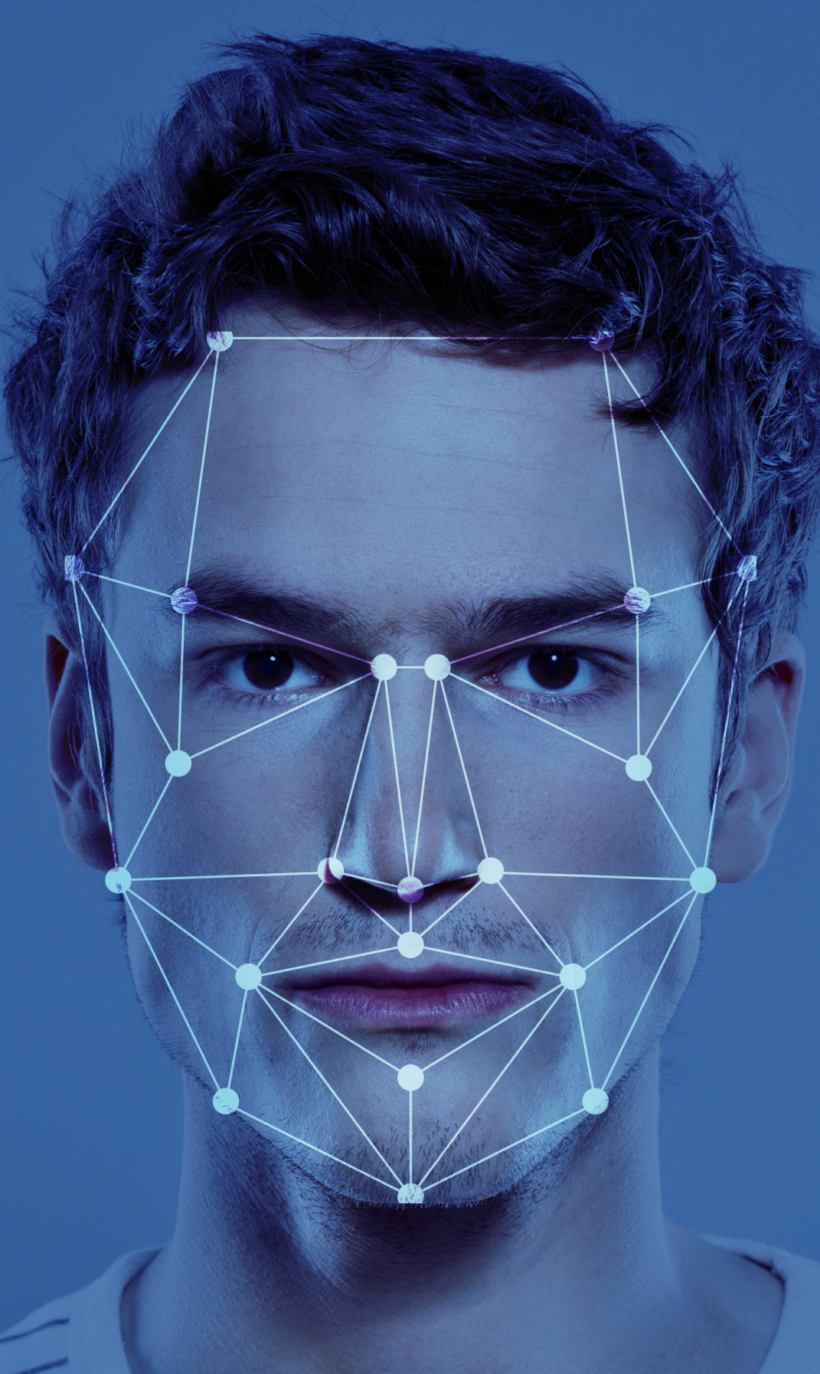
Automatic Attendance System By face recognition
By Group 4
Mohammad Faizan (100886493
Kunal Krishan Sharma (100938687)
Vandana Patter (100941405)
Sanjay Kumar (100942249)
Princeton (100934567)

Slide 2
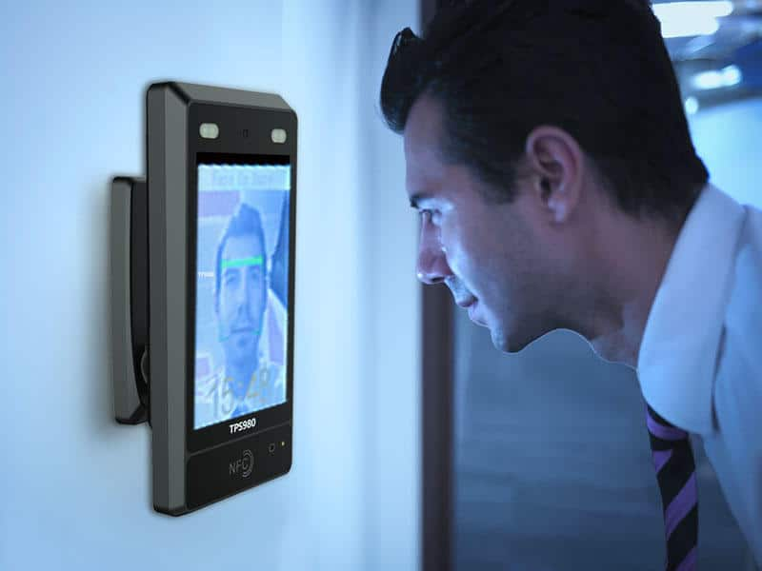
Overview
Face recognition is a step further to face detection. In face detection, we only detect the location of the human face in an image but in face recognition, we make a system that can identify humans.
It can also be stated as, "Face recognition is a broad challenge of verifying or identifying people in pictures or videos. Big tech giants are still working to make a faster and more accurate face recognition model."

Slide 3
Project stages
Face Detection: Locate faces and draw bounding boxes around faces and keep the coordinates of bounding boxes.
Face Alignments: Normalize the faces to be consistent with the training database.
Feature Extraction: Extract features of faces that will be used for training and recognition tasks.
Face Recognition: Matching of the face against one or more known faces in a prepared databasee complicated but getting started doesn’t have to be

Slide 4
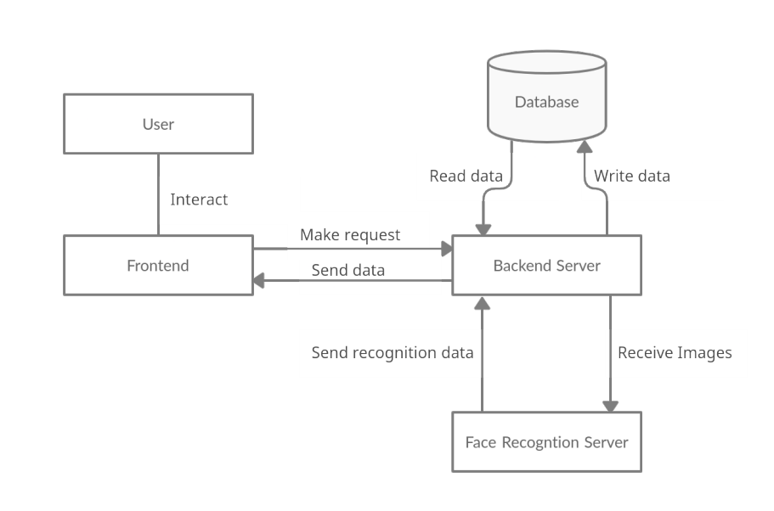
System Architecture

Slide 5
frontend technology used
Mobile Device
Webcam

Slide 6
backend technology used
Python programming language
Popular libraries such as OpenCV
Face recognition

Slide 7
Database
MYSQL
MsExcel

Slide 8
AI Features
Face Detection: Use a face detection algorithm/library like OpenCV, Dlib, or MTCNN to locate and extract faces from images or video frames.
Face Recognition: Employ a face recognition library like OpenCV, dlib, or Face_recognition to identify and recognize individual faces from the detected face images.
Machine Learning Models: Train machine learning models, such as support vector machines (SVM) or deep learning models (e.g., Convolutional Neural Networks or CNNs), to improve face recognition accuracy.

Slide 9

THANK YOU

